Slide 1
Paper Review Paper Title: Explainable Skin Lesion Diagnosis Using Taxonomies
Presented By:
Sk. Mamunur Rashid
ID: 22366050
Course Title:
Advanced Syntactic Pattern Recognition
Course Code: CSE713

Slide 2
Introduction
Skin cancer is a significant health threat, particularly in regions with high levels of ultraviolet (UV) radiation from the sun. The incidence rates of skin cancer have been steadily increasing. Skin cancer is often preventable and usually treatable if it can be detected early, So, early diagnosis and detection is very important for this type of disease.
Deep neural networks have rapidly become an important tool in many classification applications like skin cancer detection. As deep learning models are often considered "black boxes" due to their intricate architectures and millions of parameters. This significantly reduces the safety of a diagnostic system, since the physician is unable to interpret and validate the output.

Slide 3
Introduction con…
In this paper, the researchers aimed to address this major limitation as mentioned above and improve the explainability of a skin cancer diagnostic system. They proposed to combine multi-task CNNs with visualization methods to develop an explainable CADS(Computer Aided Diagnostic System) for skin cancer diagnosis.

Slide 4
Related Works
Various approaches have been proposed by the machine learning community to improve the explainability of a CNN. They focused on inspecting the features learned by the model. Two popular strategies are class activation maps (CAMs or Grad-CAMs), which highlight the image regions that contribute the most to an output, and attention modules that are trained to guide the CNN towards the most discriminative features.
CAMs have already been adopted in dermoscopy image analysis. An alternative to CAMs, is to visualize the filters learned by DCNNs. Such analysis was conducted by Van Simoens and Dhoedt for a skin cancer model. Their results showed that a CNN was able to learn filters that were sensitive to: border, lesion and skin color, hair, and artifacts. However, visualization approaches only allow the inspection of the network during the inference phase, and they improve explainability but they do not impact the performance of the network.

Slide 5
Related Works con..
An alternative to the previous approaches is to design multi- task architectures to explicitly influence the performance of the CNN and achieve more interpretable models. In this case, CNNs are designed to perform more than one related task. This formulation makes it possible to extract more discriminative features by incorporating complementary knowledge into the CNN, while at the same time improving the overall performance in the various tasks. This approach has also been adopted in dermatoscopy, by combining lesion diagnosis with either lesion segmentation or detection of dermoscopic criteria.

Slide 6
Proposed System
The proposed model significantly differs from the above ones. First, they used a recurrent neural network (RNN) to perform the hierarchical diagnosis. RNNs have been shown to perform well on hierarchical classification tasks, and are easily extended to incorporate larger taxonomies. Moreover, they addressed the explainability of the model by incorporating an attention module that can guide the RNN towards the most relevant regions and learn more discriminative features.

Slide 7

Proposed System con..
This work proposes a new CADS for skin lesions with the following properties:
it mimics the hierarchical decisions made by dermatologists, thus medical knowledge is incorporated in the design of the network;
and (ii) it is explainable, since it provides visual information regarding the most relevant regions and features in each step of the diagnosis.
Hierarchical classification may be seen as a problem of finding a set of sequential class labels ( C = { C 1 , . . . , C T } ) that better defines image I, that is the sequence that maximizes
This formulation enforces that the t-th class is conditioned on the previous ones, thus ensuring a hierarchical dependence between classes. The probability defined in (1) is used in various problems, such as the one of image captioning, where the goal is to predict the best sequence of words to describe an image.

Slide 8
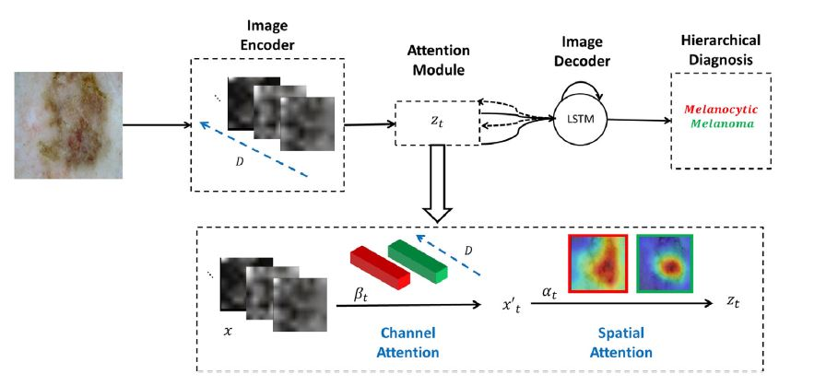
Proposed System con..
The architecture of the proposed CADS, shown on the left. The first block of the system is the image encoding one, where features are extracted from the entire images using a CNN. The last block is an RNN with a long-short term memory (LSTM) cell that is responsible for generating the sequential labels for a given dermoscopy image. At consecutive time-steps, the LSTM takes as input image features and the labels generated in the previous steps, to predict the next one. The block in the middle, called the attention module, interacts with the LSTM to define which features will be fed to the latter, taking into account the previously generated labels. The goal of the attention module is to mimic the way dermatologists analyze dermoscopy images
Fig: Block Diagram of Proposed System

Slide 9
Proposed System con..
Hierarchical diagnosis model:
The proposed hierarchical diagnosis model is formed by three main blocks, as shown in Fig : (i) image encoder, which extracts image features (ii) image decoder, which performs the hierarchical classification and iii) attention module that guides the model towards the most discriminative features and regions according to the previous output of the LSTM.
(i) Image encoder
The goal of this block is to extract discriminative features from raw images. In particular, three popular CNN architectures (VGG-16 , DenseNet-161, and ResNet-50) have been compared and the activation maps from their last convolutional layer have been selected. These maps are then vectorized and concatenated.

Slide 10
Proposed System con..
(ii) Image decoder - hierarchical classification
This block is responsible for sequentially diagnosing the dermoscopy images, following the medical taxonomy. At each hierarchical split t , the LSTM produces a finer class for the skin lesion, receiving as input the previously generated class Ct−1 , the context (image features) zt , and the previous hidden state h t−1
(iii) Attention module
The goal of the attention module is to provide the LSTM network with the most relevant image features (called the context vector zt ), that can be used to predict the t−th level of the taxonomy. This approach aims to mimic the analysis performed by dermatologists, while diagnosing skin lesions

Slide 11
Data set and experiments
The model has been developed using the ISIC 2017 and 2018 dermoscopy data sets. The first set comprises 2750 images divided into training (2000), validation (150), and test (600) sets.
These images contain examples of the following classes of lesions: melanocytic (melanoma and nevi) and non-melanocytic (seborrheic keratosis). The second set is larger and more complex, containing 11,527 examples of the following lesions: melanocytic (melanoma and nevi) and non-melanocytic (basal cell carcinoma, actinic keratosis, benign keratosis, dermatofibroma, and vascular lesions). Similarly to ISIC 2017, the 2018 data set is also divided into training (10,015) and test sets (1512).

Slide 12
Model training
The following configuration was considered to train the model:
(i) Image encoder ii) Hierarchical loss function
iii) Channel attention iv) Class inference v) Model hyperparemeters
Each of the model’s configurations mentioned above was trained end-to-end.
The model is optimized end-to-end using the Adam variation of the stochastic gradient descent with mini-batches of size 20, using an initial learning rate of 10 ⁻⁶ , which decays at every 200 epochs. In total, the model is trained for 600 epochs with an early-stop criterion on a NVIDIA Titan Xp.

Slide 13
Model Evaluation and Experimental Results
All of the trained model configurations were evaluated using an independent test set, and the performance was quantified using the following metrics: sensitivity ( SE ), specificity ( SP ), balanced accuracy ( BACC ), and area under the curve (AUC). The metrics SE SP , and AUC are class specific, while BACC is computed over the entire data set.
It is observed that enforcing the hierarchical structure in the loss function improves the performance of the models, particularly when ResNet-50 and DenseNet-161 are used as image encoders. Moreover, if we compare the SE and SP values of the keratosis class (the only non-melanocytic lesion) with those of the melanocytic/non-melanocytic task, we conclude that only the hierarchical loss guarantees that the model does not violate the taxonomy.

Slide 14
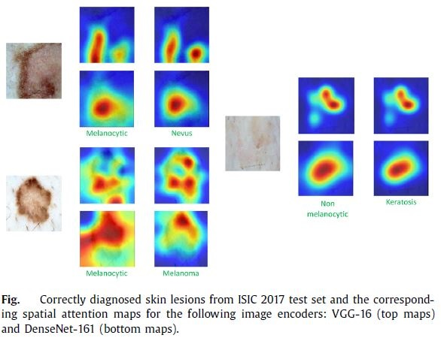
Model Evaluation and Experimental Results con..
According to these results, it seems that ResNet-50 performs worse than the remaining image encoders and that DenseNet-161 seems to be the encoder that better captures the properties of the various classes.

Slide 15
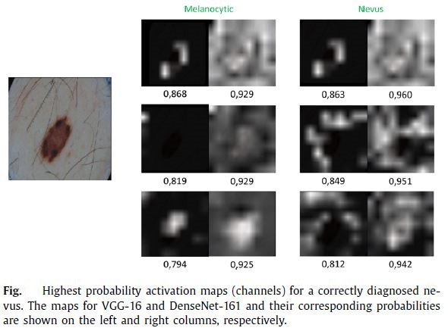
Model Evaluation and Experimental Results con..

Slide 16
Model Evaluation and Experimental Results con..
Two observations can be made regarding the attention maps: i) VGG-16 leads to more detailed maps, although it achieves slightly worse diagnostic performances; and ii) both models “attend” to regions that are relevant for the medical diagnosis and are able to show regions of interest, even when the lesion is difficult to distinguish from the surrounding skin.

Slide 17
Limitation
Color normalization has a positive impact on the performance of CNN. It is important to standardize the color of dermoscopy images through normalization. Future work should address the perception of color by CNNs, in order to make them more robust to color changes. A few works investigated the sensitiveness of CNNs to color using real images. However, such a study is still missing in the dermoscopy field.

Slide 18
Conclusion
The experimental results show that the model can identify clinically relevant regions in the images and use them to provide a diagnosis. Additionally, the model explainability helps understand how changes in the viewpoint influence classification performance. Both factors also reveal new directions of research that can make CNNs safer to be applied in clinical practice.

